Slide 1




#RintisKarirImpian
Portofolio - Intensive Bootcamp
Introduction to Problem Solving
Owner: Muhammad Ferdy Fawwaz
Build your skill and portfolio via myskill.id/bootcamp

Slide 2

Mini Task
Halojek is a company with 2 main product:
Halofood : a service to provide food delivery
Haloride : a service to provide mobility using motor cycles
The revenue on this quarter (Q3, 23) is decreased for 50% compared to same quarter last year (Q3, 22)

Slide 3
Mini Task (Cont)
The cost for this quarter is as follow:
Marketing cost : IDR 800 Bio,
Labor cost: IDR 750 Bio
Infrastructure cost: IDR 3,500 Bio
The cost for last quarter is as follow:
Marketing cost : IDR 600 Bio,
Labor cost: IDR 600 Bio
Infrastructure cost: IDR 2000 Bio
Objective: Develop problem solving framework for the case above, you are a data analyst to deep dive the root cause of cost increasing on this quarter and also provide the alternative

Slide 4
Step 1: Clarify the Problem
Clue: Quantified the gap
Ideal Condition:
Pendapatan Q3 2023 setara atau lebih tinggi dari Q3 2022, pengeluaran operasional tetap efisien (stabil atau turun).
______________________
Gap:
Penurunan revenue sebesar 50% dan peningkatan biaya IDR 1,850 Bio (terutama dari infrastruktur).
__________________________
Existing Condition:
Pendapatan Q3 2023 turun 50% dibanding Q3 2022, total biaya operasional naik signifikan terutama pada infrastruktur.
______________________
#RintisKarirImpian

Slide 5
Step 2: Breakdown the Problem
Clue: Should be data driven | 4W - What, Where, Who, When
Ideal Condition:
Revenue stabil atau naik + biaya operasional terkendali.
_________________
Revenue Decrease
___
Marketing Cost Increase
(kenaikan dari 600 Bio → 800 Bio)
___
Gap:
Selisih pendapatan dan peningkatan biaya menyebabkan margin sangat tertekan.
________
Cost Increase
___
Labor Cost Increase
(kenaikan dari 600 Bio → 750 Bio)
___
Existing Condition:
Revenue turun 50% + biaya naik signifikan.
_________________
Infrastructure Cost Increase
(kenaikan dari 2,000 Bio → 3,500 Bio)
__
#RintisKarirImpian

Slide 6
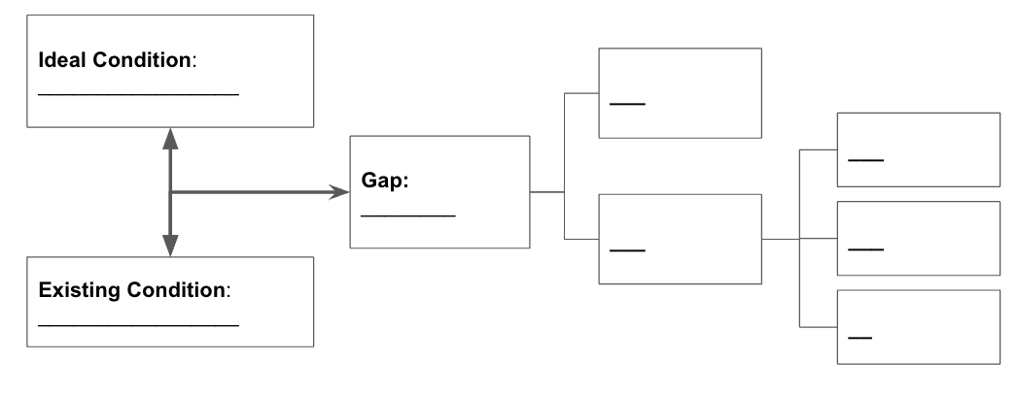
Step 3: Set the Objective
Clue: objective should be quantified and time-bound
Objective
_____
#RintisKarirImpian

Slide 7
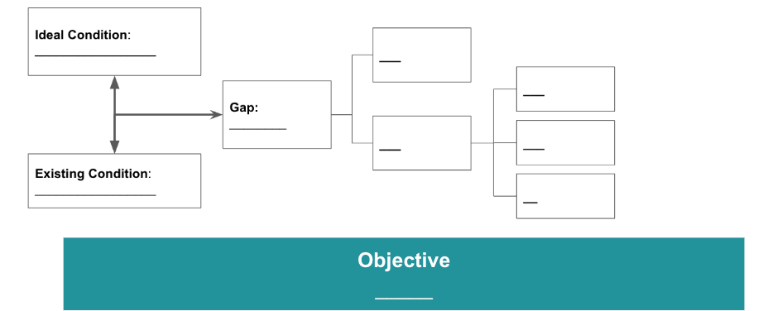
Step 4: Define the root cause
Clue:
Why, why, why
Brainstorm is allowed
Hypotheses Root cause 1
Hypotheses Root cause 2
Hypotheses Root cause 3
Hypotheses Root cause 4
#RintisKarirImpian

Slide 8
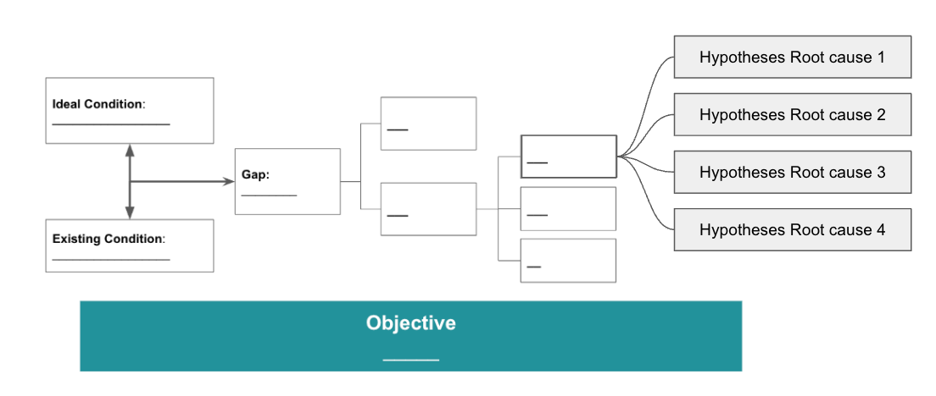
5. Develop Countermeasures
#RintisKarirImpian

